Slide 1

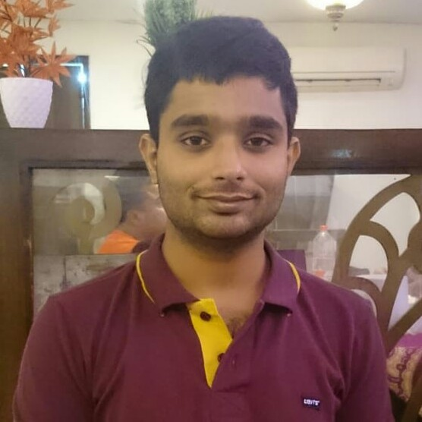






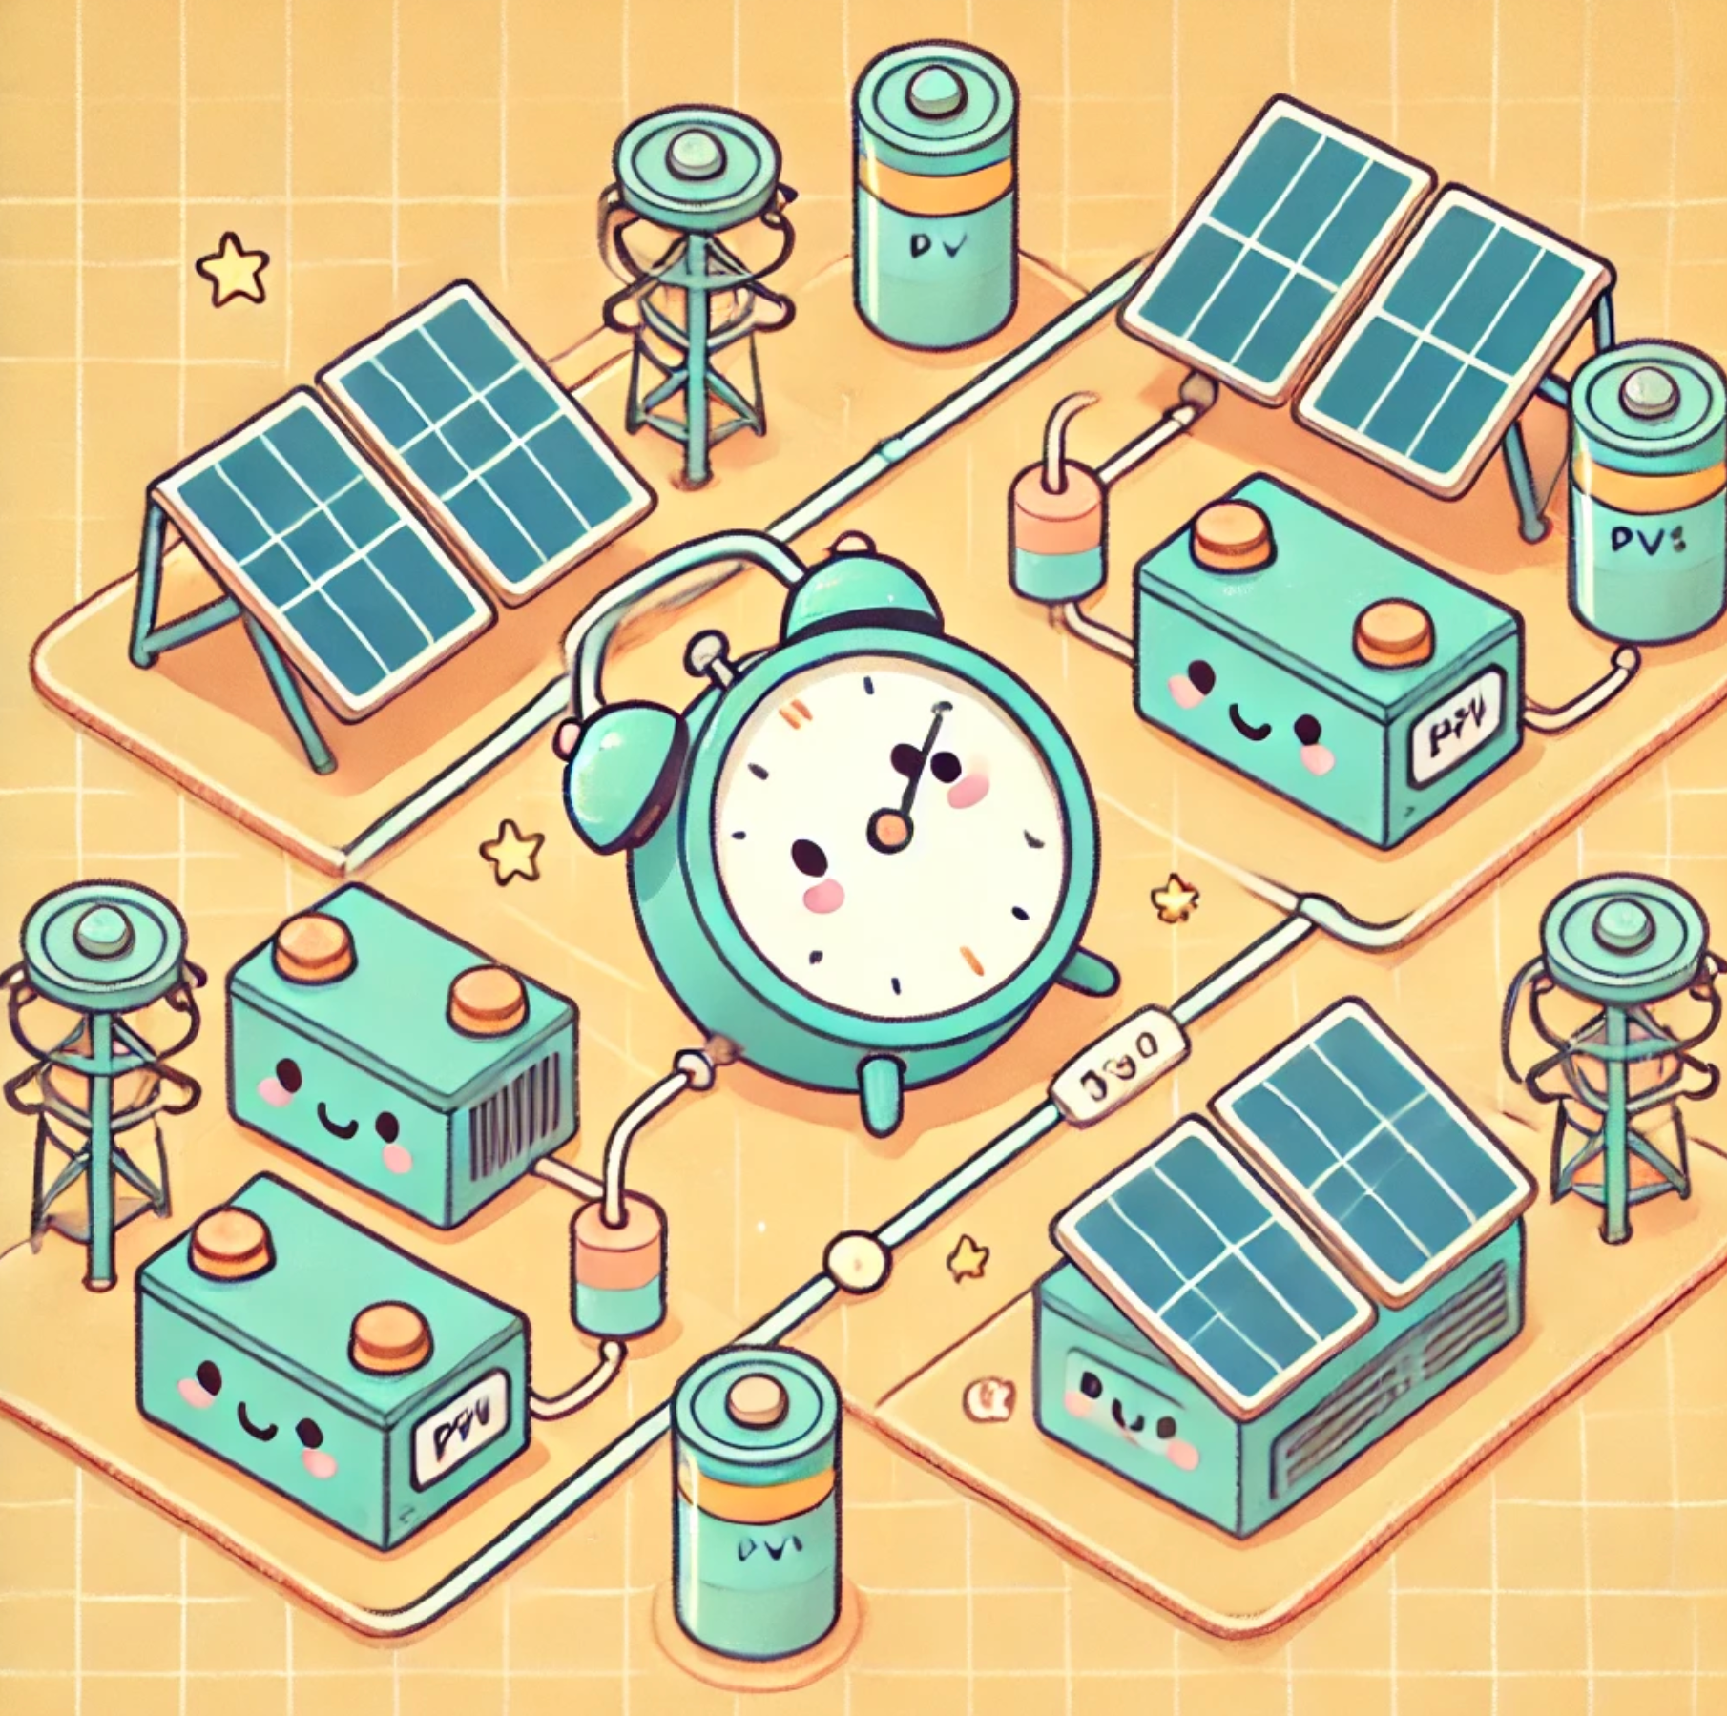

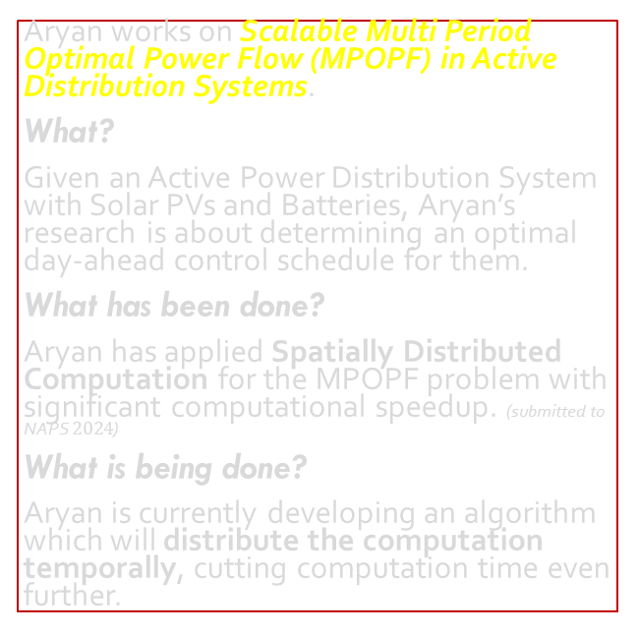
Aryan Ritwajeet Jha Graduate Research Assistant¹ Supervisor: Dr. Anamika Dubey, Associate Professor¹ Degree: PhD in Electrical and Computing Engineering Started: Fall 2022 Expected Graduation: Summer 2026 Desired Post Graduation Move: Power Engineering Industry, Utility or R&D in DOE National Labs ¹ Energy Systems Innovation Center, School of Electrical Engineering and Computer Science, Voiland College of Engineering, Washington State University, Pullman
Research
Aryan works on Scalable Multi Period Optimal Power Flow (MPOPF) in Active Distribution Systems.
What?
Given an Active Power Distribution System with Solar PVs and Batteries, Aryan’s research is about determining an optimal day-ahead control schedule for them.
What has been done?
Aryan has applied Spatially Distributed Computation for the MPOPF problem with significant computational speedup. (submitted to NAPS $2024$)
What is being done?
Aryan is currently developing an algorithm which will distribute the computation temporally, cutting computation time even further.
Previous Experiences
Summer 2024 Intern at NERC in their Advanced System Analytics and Modelling team
2020-2022 Graduate Research Assistant at Indian Institute of Technology, Delhi, India
2016-2020 BE EEE at Birla Institute of Technology and Science Pilani, Hyderabad, Telangana, India
Notes:
Remember to hit the reset button to make sure all the page elements react properly.
There are 20 different layouts that you can choose from.

